Slide 1
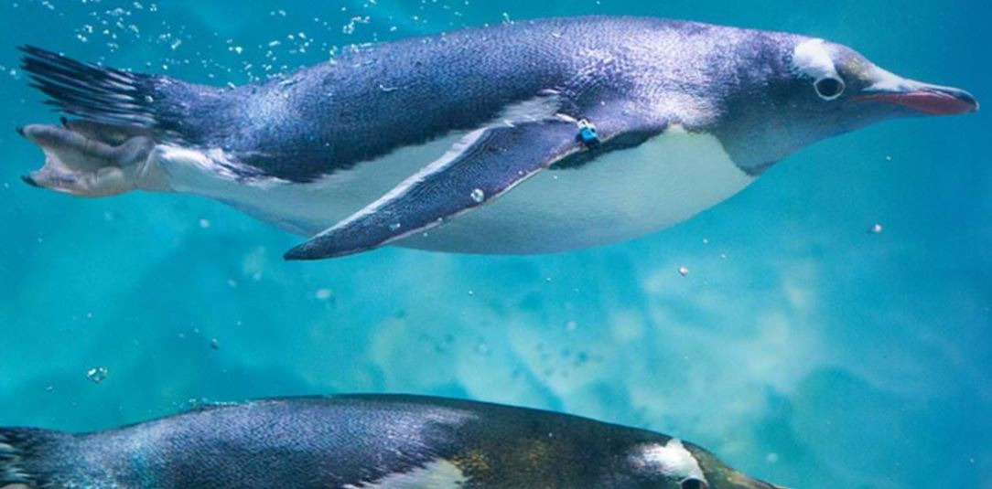
Penguins
Jackson Lisi

Slide 2
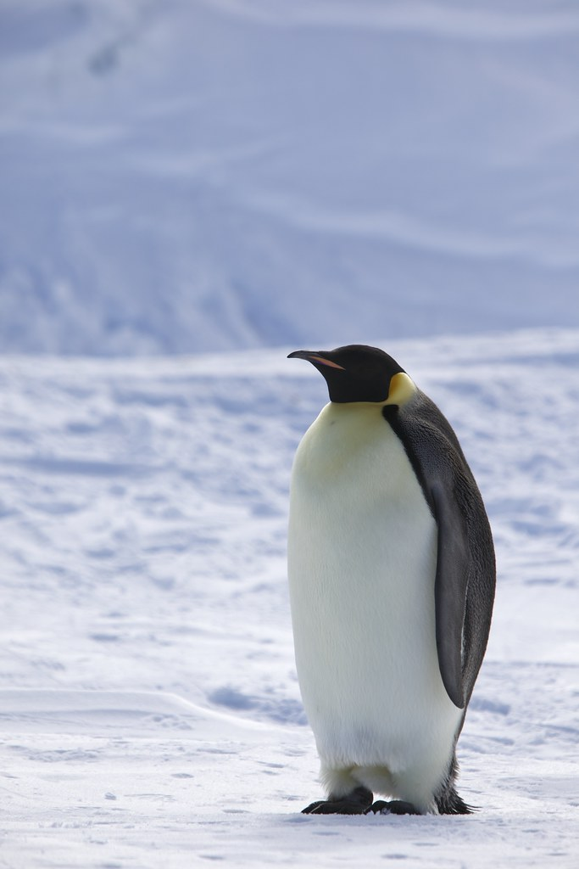
Where do they live?
Penguins live in the Southern Hemisphere and the Islands that surround Antarctica. In fact they live on Antarctica itself. They also live in Africa, New Zealand, and The Galapagos Islands.

Slide 3
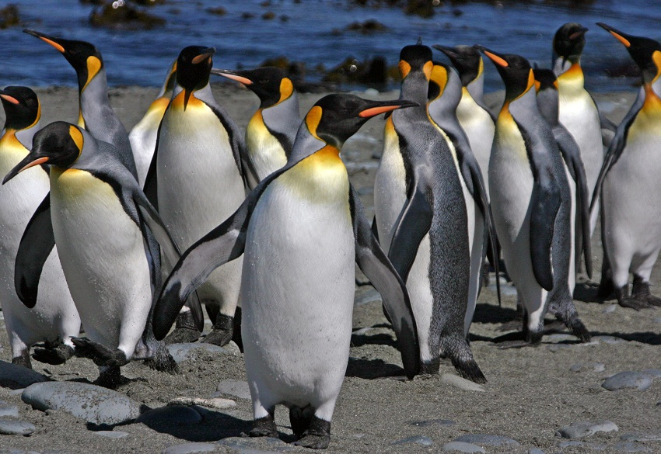
Why are they black ?
When predators look down they will not spot the penguins dark color on the top. When predators look up they can only spot the sun light and if they see the penguin they will only see the white belie so they will not hunt it because they cant tell the difference same when flying predators look down except the dark color on the top blends in with the dark ocean.

Slide 4
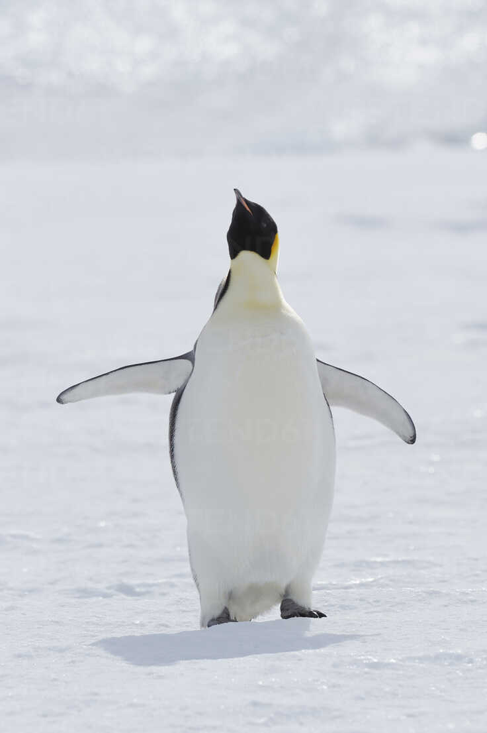
Wings
Unlike flying birds penguins do not have flexible wings. Penguins bones are dense and stronger. There flippers are very hard and strong.

Slide 5
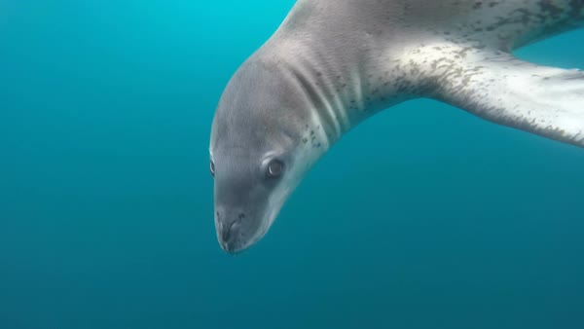
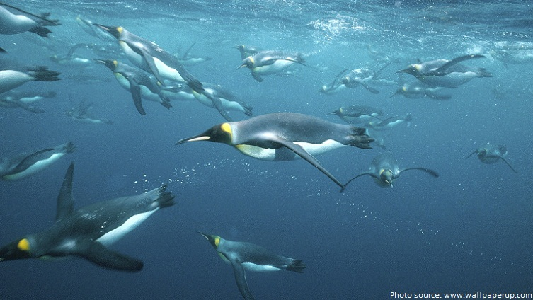
Predators
Penguins have many predators In fact some are Sealions, Leopard Seals, and Orca Whales. Orca Whales hunt and eat adult penguins. Seagulls and other sea birds eat penguin chicks.

Slide 6
How do penguins stay warm
All penguins use blubber to stay warm. Blubber is a type of fat that animals in cold climates have so they don’t freez. A Down is a fluffy bunch of inner feathers.

Slide 7
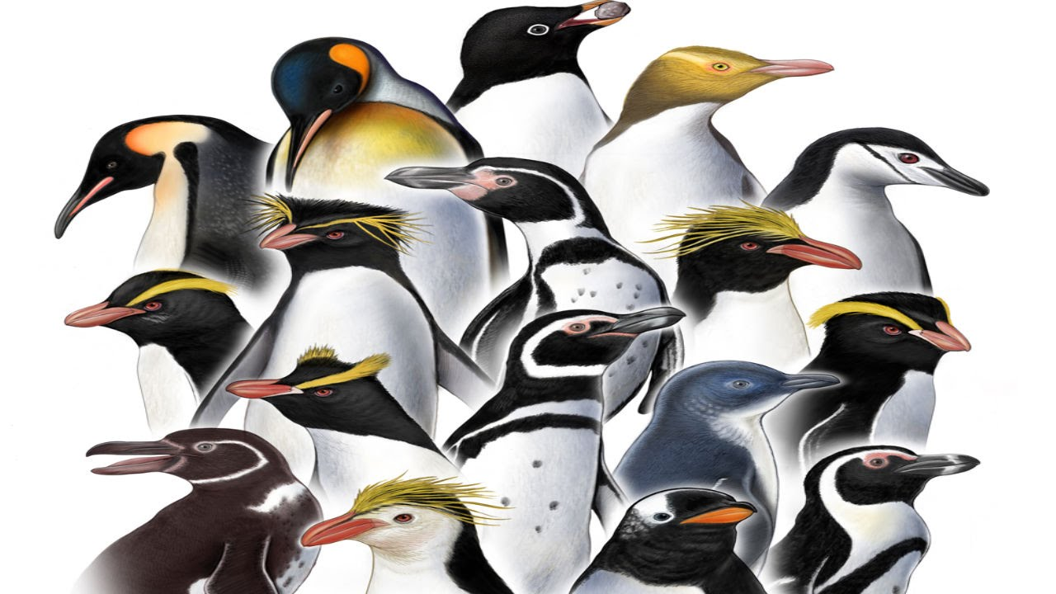
Types of penguins
Emperor penguins stand about 3 feet tall. Male Emperor penguins warm their eggs by standing on them. Male Emperor penguins have something called a Broad Patch a Broad patch is a patch of featherless skin.

Slide 8
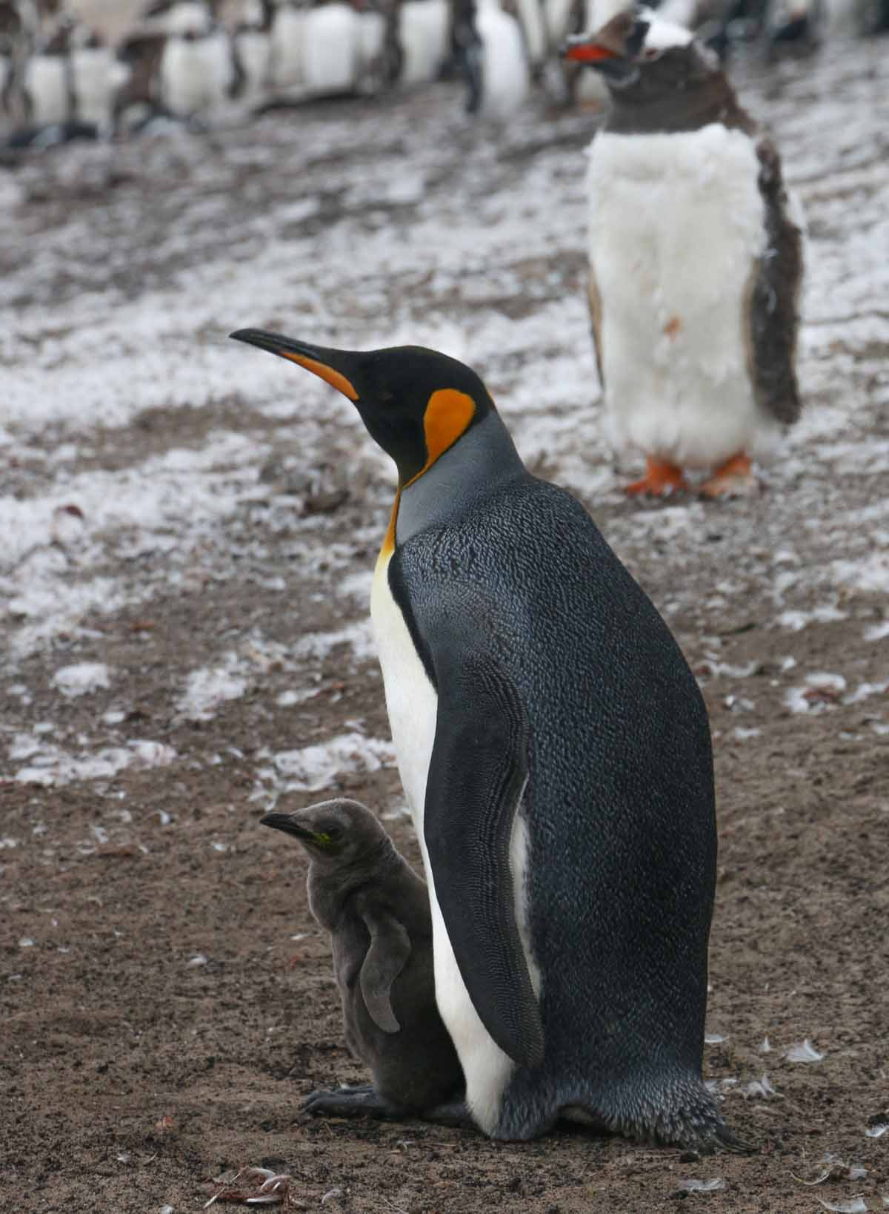
King Penguin
The King Penguin is the second largest penguin in the world. With their orange patches King penguins are easy to spot. King Penguins raise their young in the summer.

Slide 9
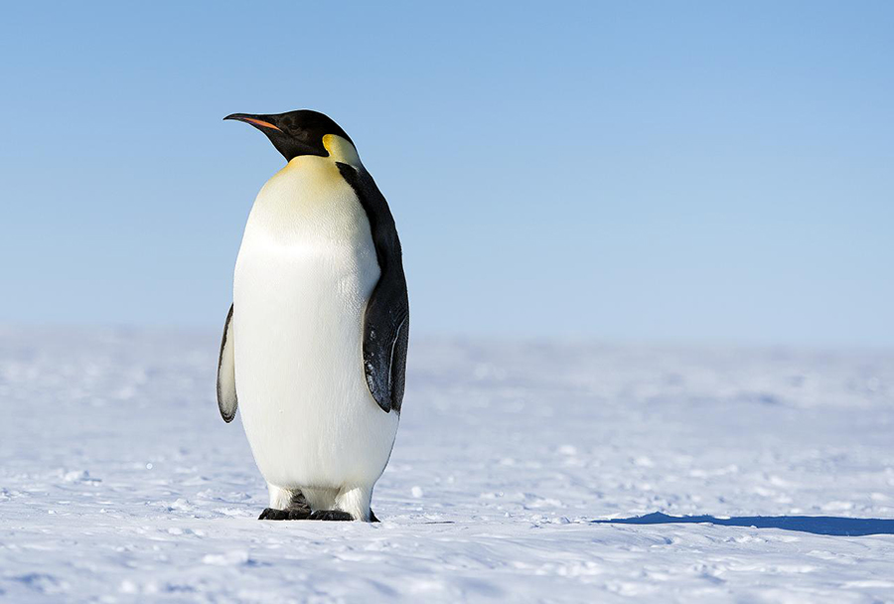
Emperor Penguin
Emperor penguins have a layer of fat called blubber. Groups of young Emperor penguins warm them selves by huddle when cold. Emperor Penguins breath very cold artic air.

Slide 10
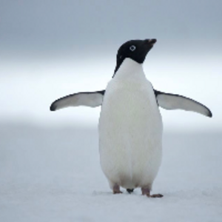
Adelie Penguin
Young Adelie Penguins spread their feathers on the shore. Adelie Penguins grown to two feet tall. Adelie Penguins lay their eggs on rocky beaches.

Slide 11
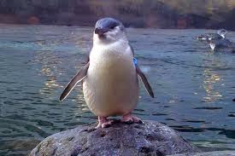
Little Blue Penguin
The Little Blue Penguin is the smallest penguin in the world. Male Little Blue and female help raise the chicks. It is also known as the Fairy Penguin.

Slide 12
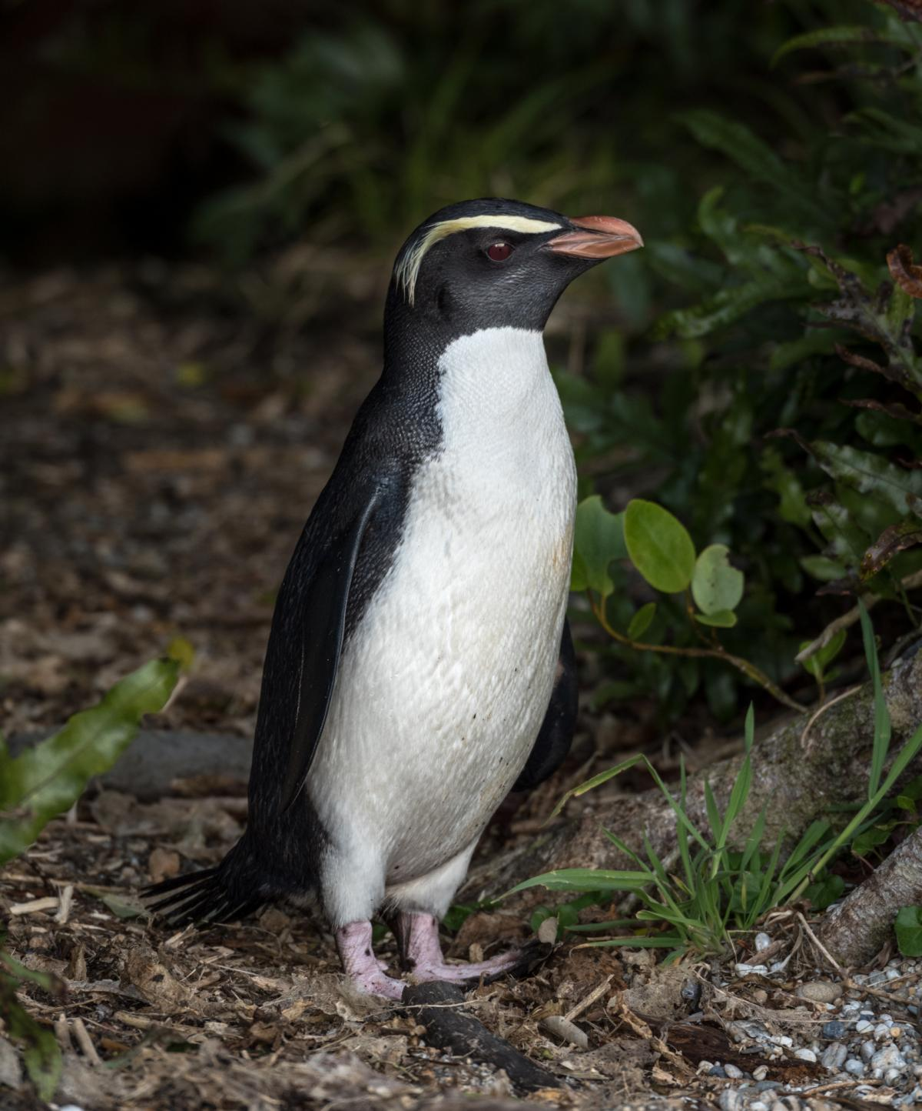
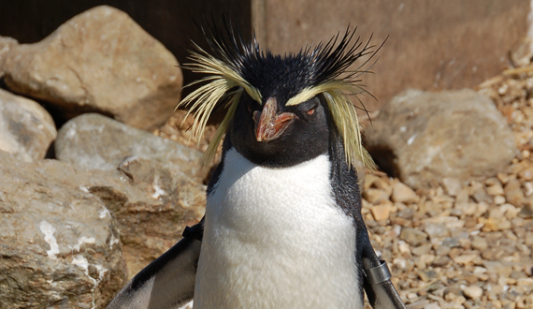
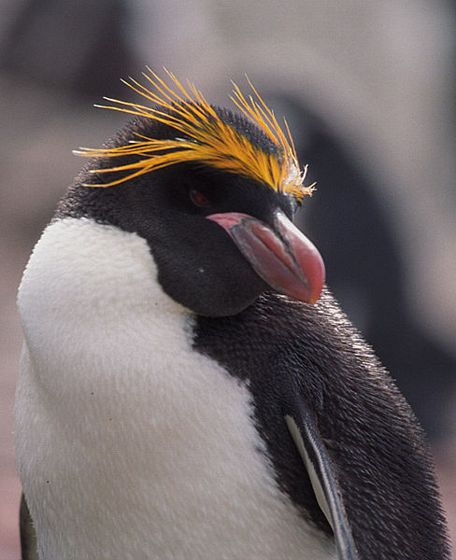
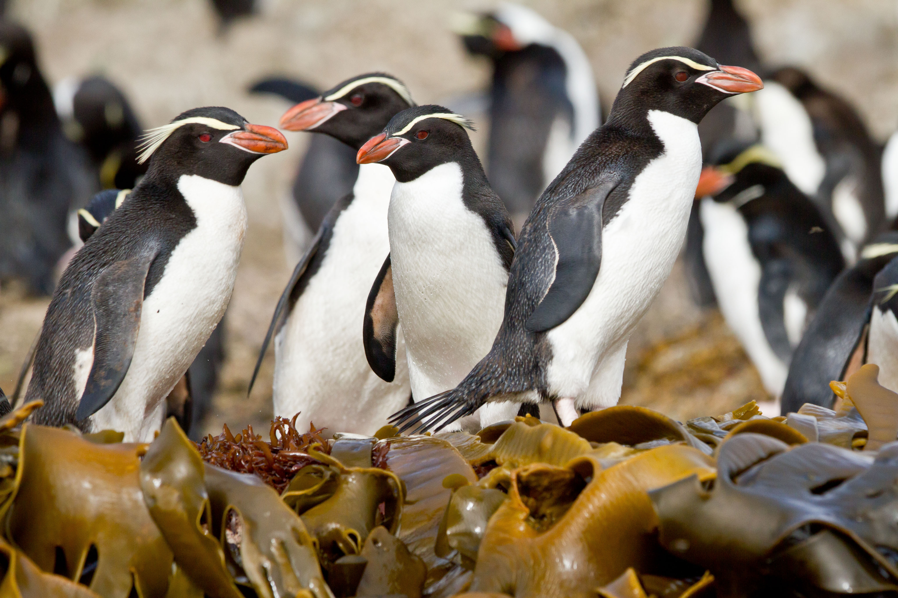
Crested Penguins
There are six different species of crested penguin. A crest is a tuft of feathers that sticks up from a birds head. Crested penguins live on the islands south of South America, Africa and New Zealand.

